Slide 1
Offshore Wind in the United States & the United Kingdom
Regulatory Framework and Case Scenarios

Slide 2
Table of Contents
Part I: Regulatory Framework in the United States
Part II: Environmental Considerations
Part III: Politics
Part IV: Case Study Examples
Part V: Comparison with the U.K.

Slide 3
Part I: Regulatory Framework in the United States

Slide 4
Jurisdictional Determinations
Siting: if the offshore wind farm is to be located:
< 3 miles from shore | > 3 miles from shore
STATE jurisdiction | FEDERAL jurisdiction
Federal Coastal Zone Management Act provides an umbrella for federal and state permits
Essentially, in order to receive a permit for federal waters, a developer’s proposal must comply with the neighboring state’s regulatory criteria (and vise versa), EVEN IF outside of direct state jurisdiction

Slide 5
Process of Application
If you are a developer and wish to construct an offshore wind farm in American waters, you must undergo the following process with the respective government agency (again, depending upon the location of the project):
Dept. of Interior (Fed. Gov’t)
Complete surveys and EIA for permit
Continually conduct monitoring during construction and post-construction
U.S. Marine Corp (State Gov’t)
*note: process is the same, governing agency changes
SPECIAL NOTE: Thus far, all off shore wind projects proposed or constructed have been within federal waters. There is not yet a state-specific example.

Slide 6
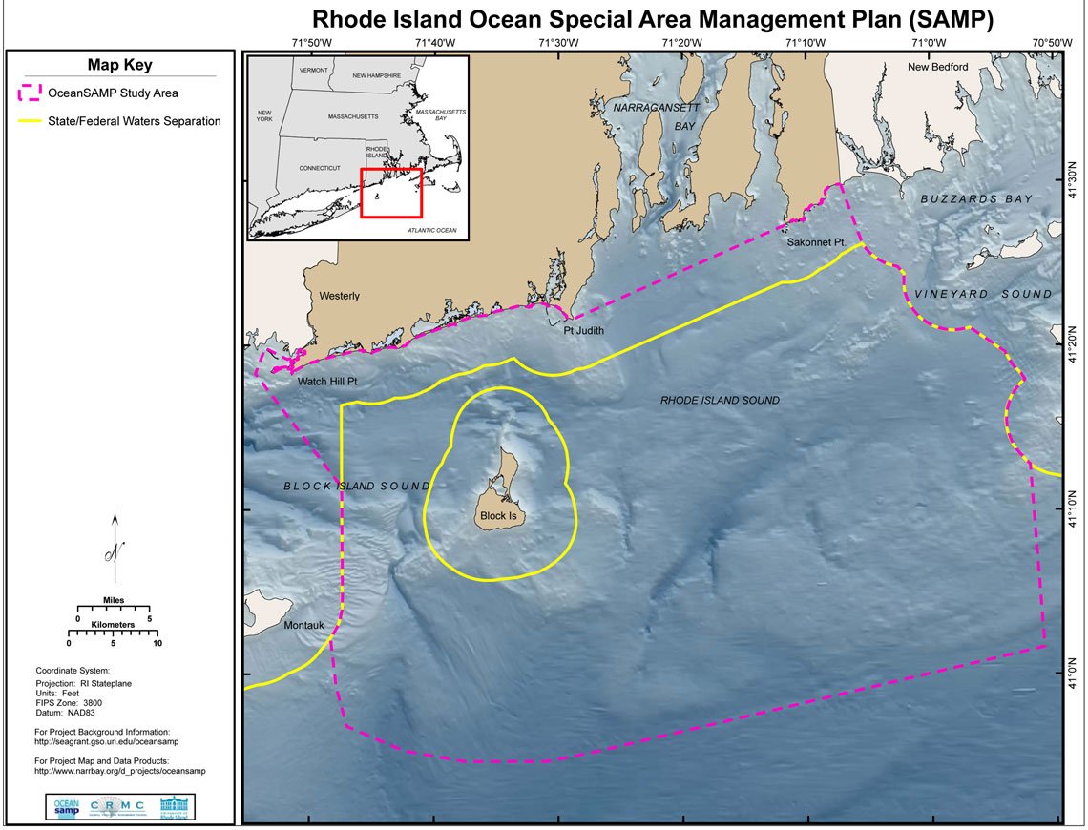

Slide 7
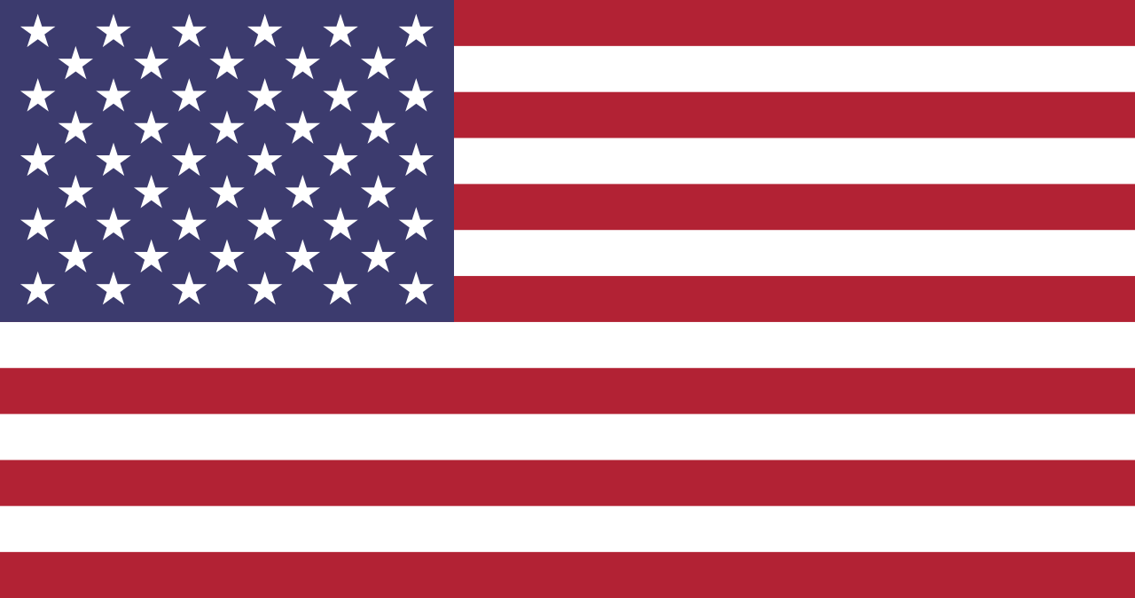

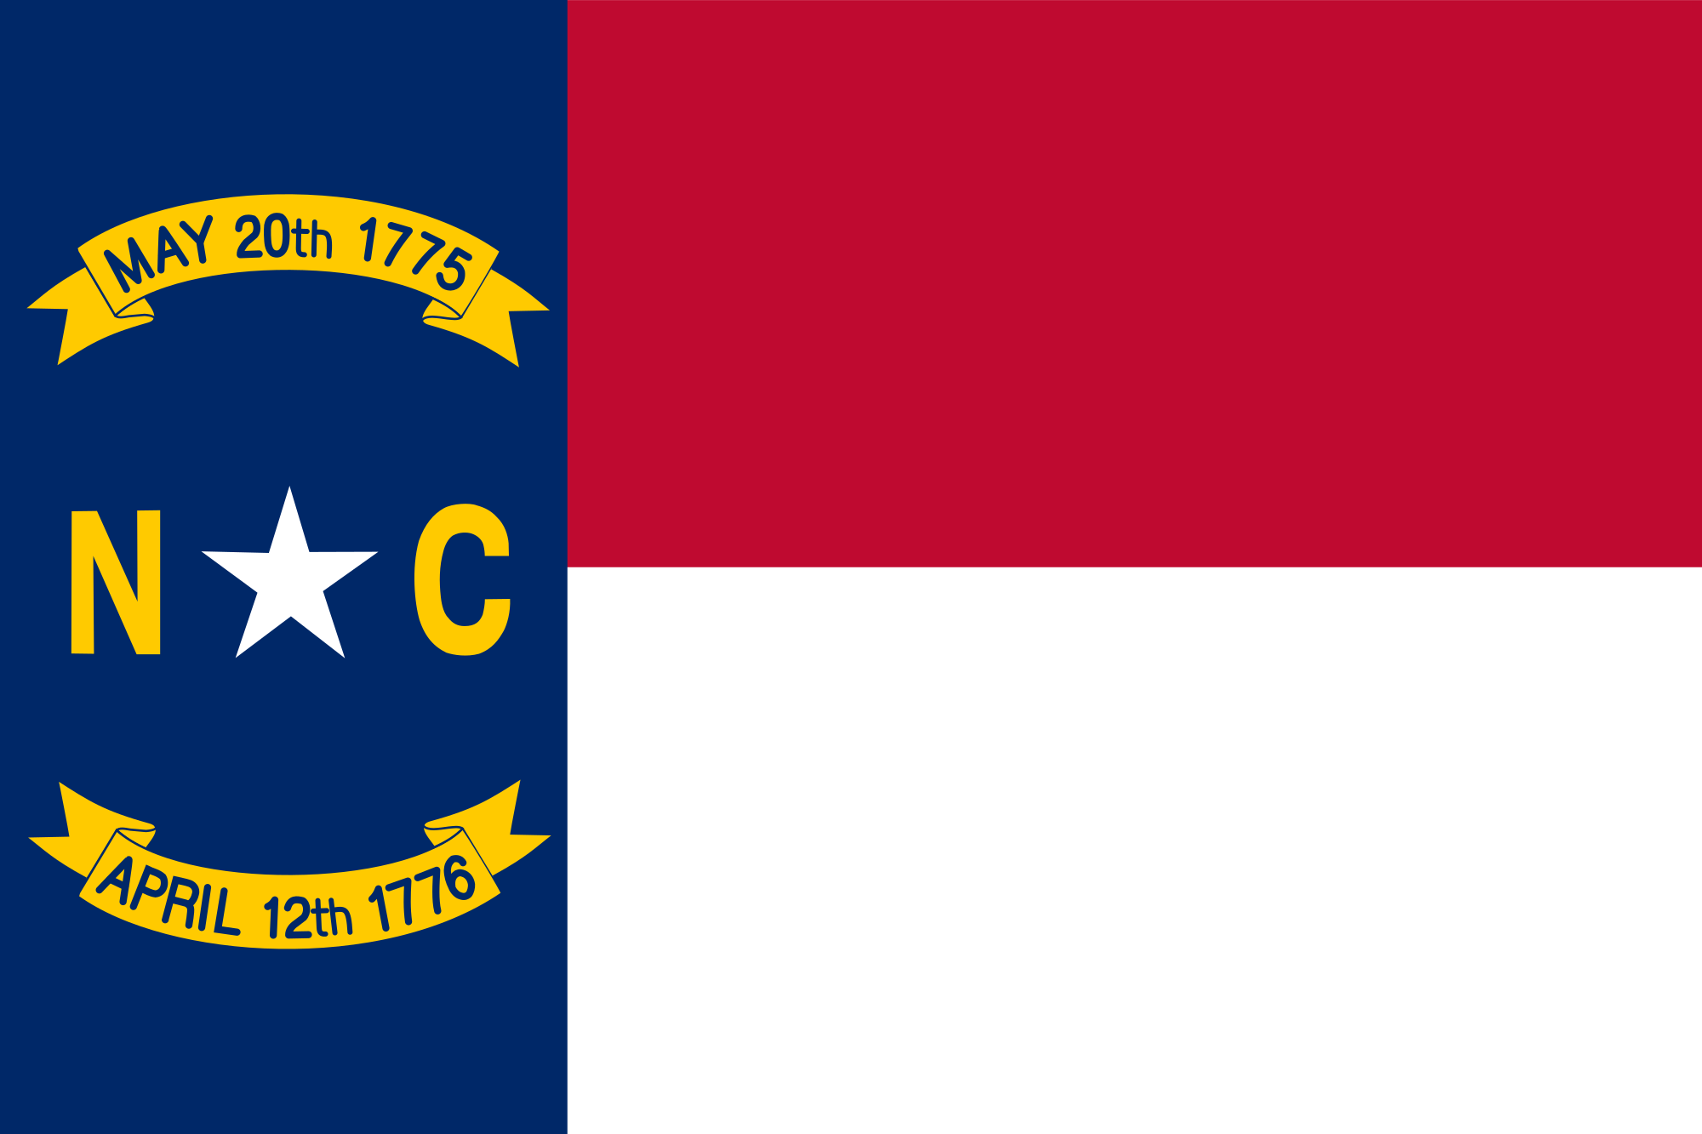
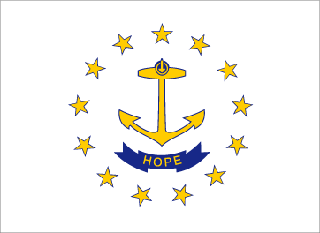
Diving into the details…
Differentiating processes:
Federal
State

Slide 8
Federal-Level Regulatory Framework (1)
Department of the Interior (specifically the Minerals Management Service, or MMS, which is a part of the Bureau of Ocean Energy Management) permits for use of federal submerged land (>3 miles from shore)
Note: Bureau of Ocean Energy Management (created in 2010 under the Obama Admn., presides over ALL marine land use. MMS is a specific wing that issues permits.
National Environmental Policy Act mandates environmental review process prior to permitting (see following section for more details)
The MMS must also ensure that the developer’s proposal meets neighboring State regulations, as some states have stricter limits than the federal government’s apparatus (e.g. California)

Slide 9
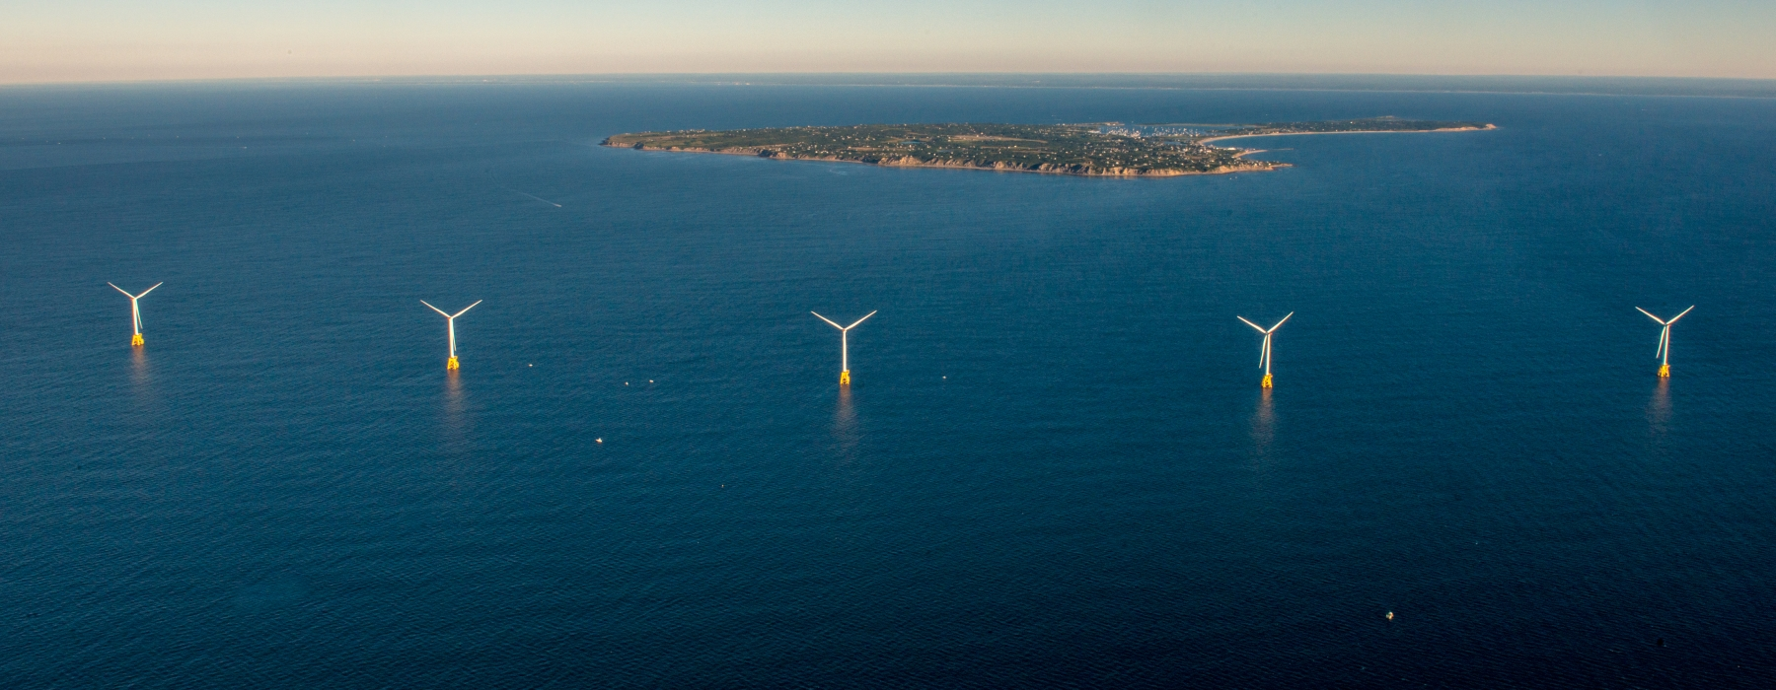
Federal-Level Regulatory Framework (2)
Similarly to state-level process, the MMS provides the developer with siting options after the research is concluded
Note: no public information regarding avg. application duration nor wait time for issuing of a license

Slide 10
State-level Regulatory Framework (1)
Bourgeoning framework
U.S. Marine Corp acting state agent
State-level ocean master plans act as a guideline for developers, as they essentially assist with:
1) identifying preferred sites for offshore wind farms;
2) conducting specific studies which the developer will have to complete before any development occurs, and;
3) establishing specific standards and policies for construction, operation and decommissioning

Slide 11
State-level Regulatory Framework (2)
Once environmental studies have been conducted and local/state/federal policies have reviewed, the U.S. Marine Corp provides the developer with siting options (assuming there are available siting options)
The developer may choose between the options and the state agency will issue the final permit needed for initiating construction
If the developer wishes to build in an area not identified by the State as a permitted area based on research, then the process must start again from scratch

Slide 12
Part II: Environmental Considerations

Slide 13
Federal Environ. Regulations
Extremely complex and overlapping
11 federal laws that must be considered prior to the issuing of a final permit
Ex 1: Magnuson-Stevens Fishery Conservation Act
(protecting fish habitats from harmful developments)
Ex 2: Endangered Species Act of 1973
(prohibits development within the habitats of endangered or extinct species)
Ex 3: Clean Water and Clean Air Acts
(pollution control permit system, pertinent to construction phase more so than operational)
Ex 4: Federal Aviation Act
(prevents the disruption of air traffic)

Slide 14
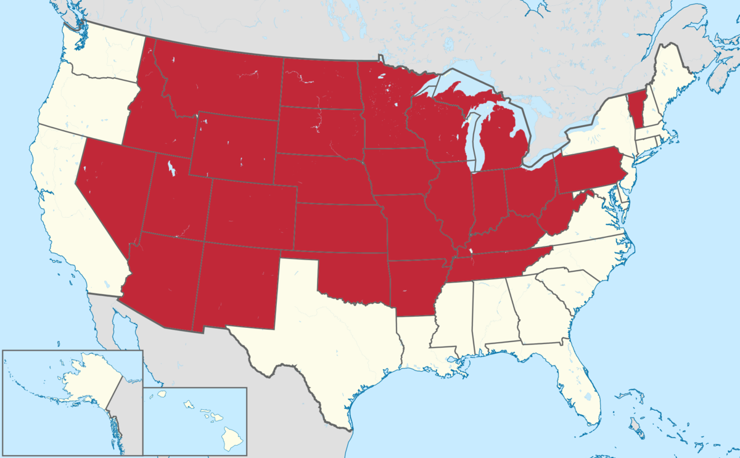
State/Local Environ. Regulations
23 states with shoreline, 6 additional states that border significant bodies of water (the Great Lakes)
Each state has a body of environmental regulations that are developed from the framework of federal environmental regulations; however, state regulations can build on federal regulations and require additional restrictions to be considered

Slide 15
Part III: Politics

Slide 16
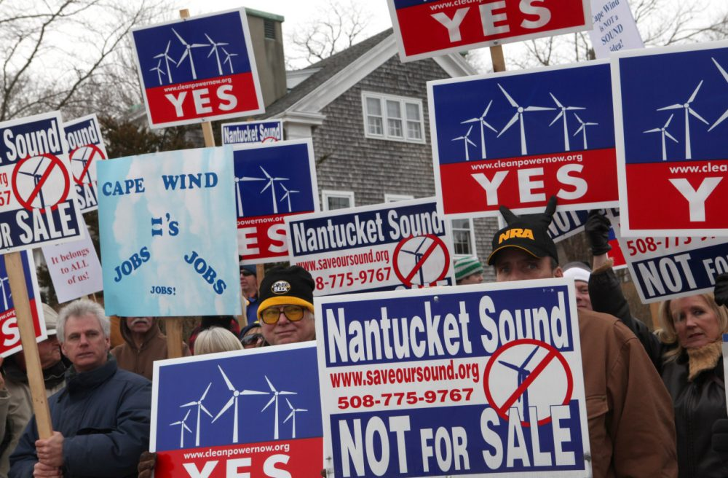
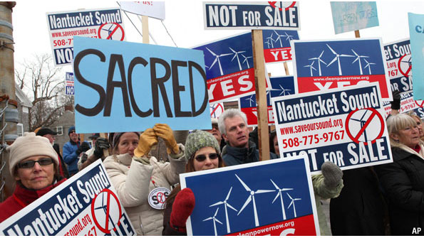
Political Opposition
Ex 1: The U.S. Navy has attempted to prohibit the development of offshore wind farms off the coast of states, such as in California (see following page)
However, the Department of Defense, while a federal agency that supersedes the authority of state agencies, does not have final authority over federal waters
Ex 2: Conservative special interest groups have blocked the development of offshore wind farms, such as the famous example of the Cape Cod Wind Farm (more details in the following section)

Slide 17
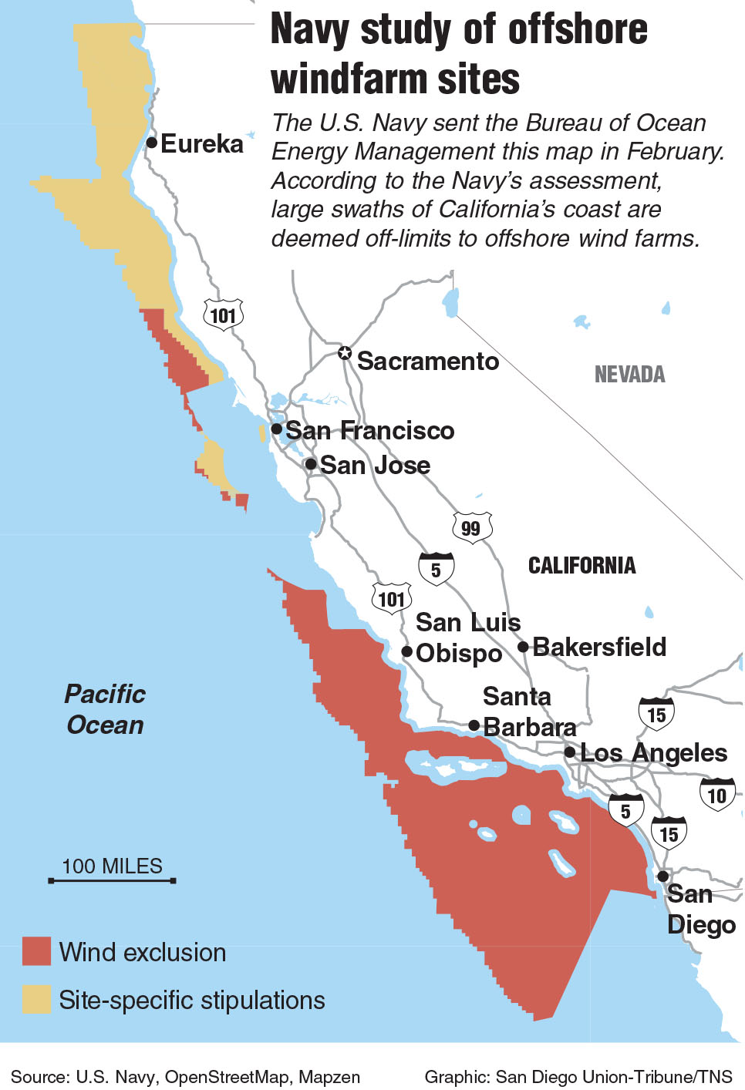
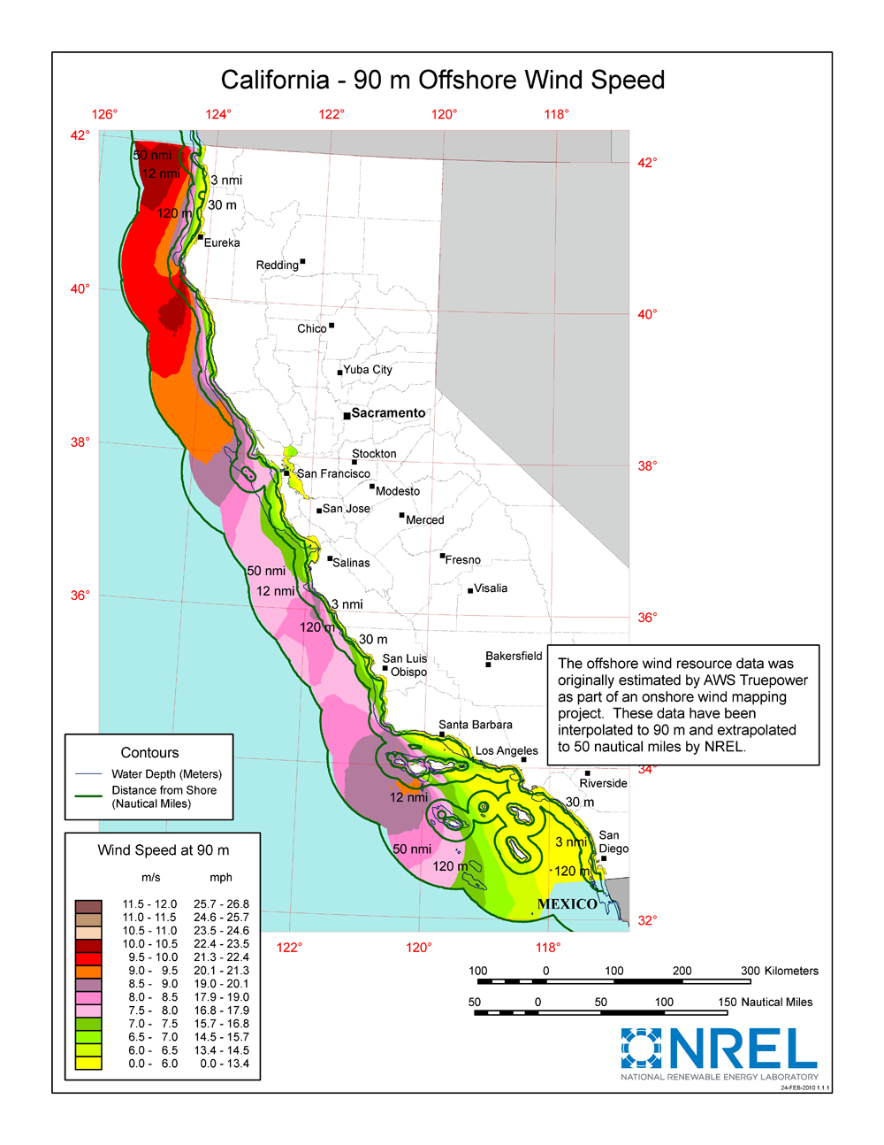
The U.S. Navy’s study would severely limit the development of offshore wind off the coast of California. The entire Southern California region is blocked off, with stipulations covering much of the north.

Slide 18
Part IV: Case Study Examples

Slide 19
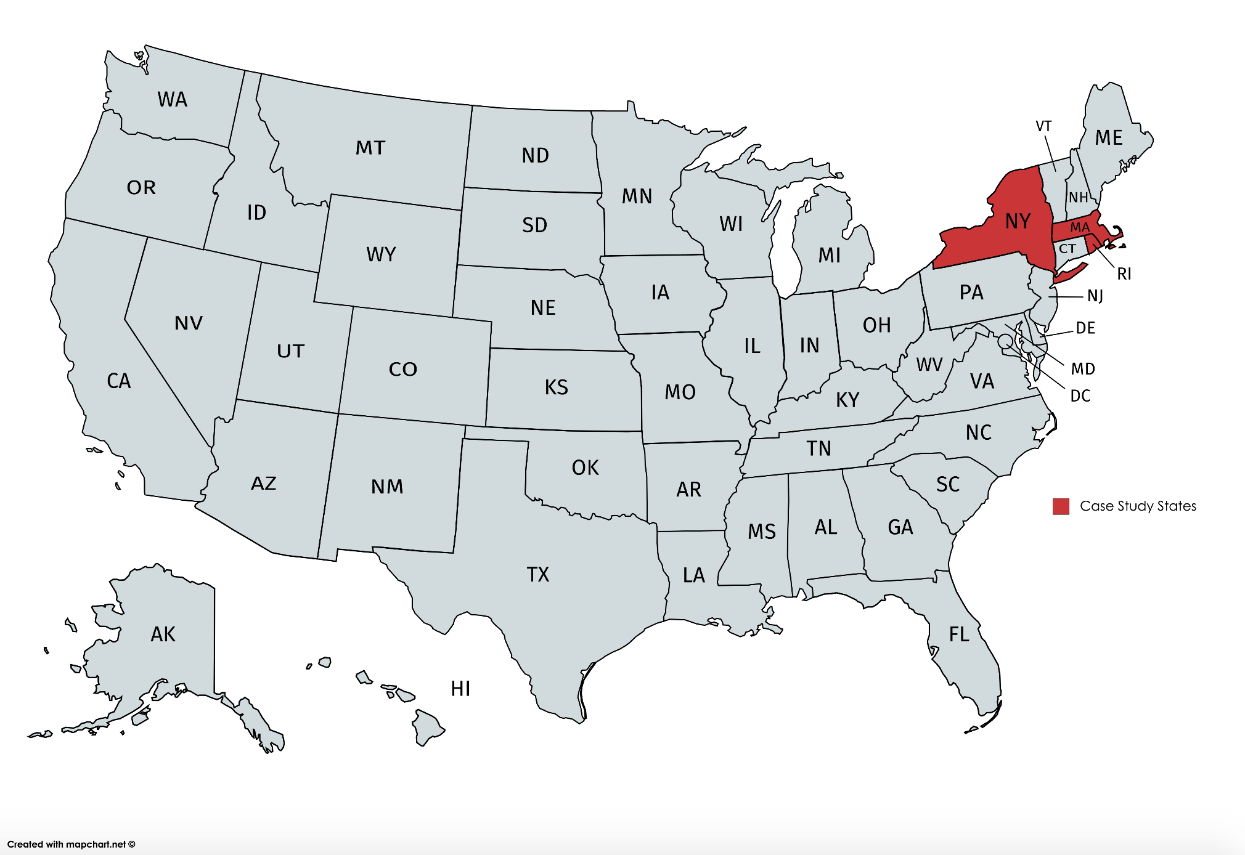

Slide 20
Case Study 1: Massachusetts
2001: environmentalist and businessman Jim Gordon proposed Cape Cod Wind Farm, set to be the USA’s first offshore wind farm
Massive project: 130 wind turbines, power 200k homes, projected $2.6 billion project
Site: >3 miles from shore, federal jurisdiction
Siting sparked fierce opposition:
Wealthy homeowners angry over “ruined view”
Fishermen concerned about impact on marine habitats
Local Native American tribe opposed due to the Nantucket Sound being considered sacred ground

Slide 21
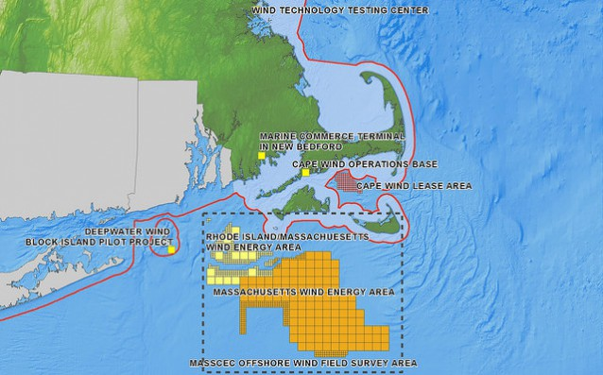

Slide 22
Massachusetts, continued
The Koch Brothers, conservative billionaires, and the Kennedy Family, wealthy political family, both led loud, public protests against the project
2013: the Koch Brothers formed the “Alliance to Protect Nantucket Sound”, a conservative non-profit with the sole objective of preventing the development of the wind farm.
The apparatus allowed for greater private funding opportunities, gave wealthy land owners cover to take the project to court, use the courts as a weapon to delay the process indefinitely
2017: after 16 years and $100 million sunk, the project was declared dead due to loss of interest from investors and an inability to continue with the pre-determined development schedule

Slide 23
Case Study 2: Rhode Island
2010: the State of Rhode Island established the Rhode Island Ocean Special Area Management Plan (SAMP)
Within this apparatus, the State established a framework for offshore wind development
2016: private developer “Deepwater Wind” began operation of America’s first offshore wind farm.
Block Island Wind Farm: 5 turbines, 17k homes
Tiny vs. existing international farms, but significant in that it sets a precedent for other wind farms in the USA.

Slide 24
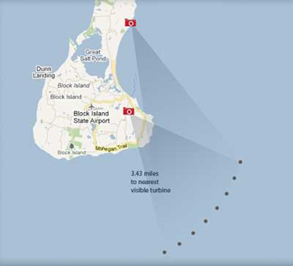
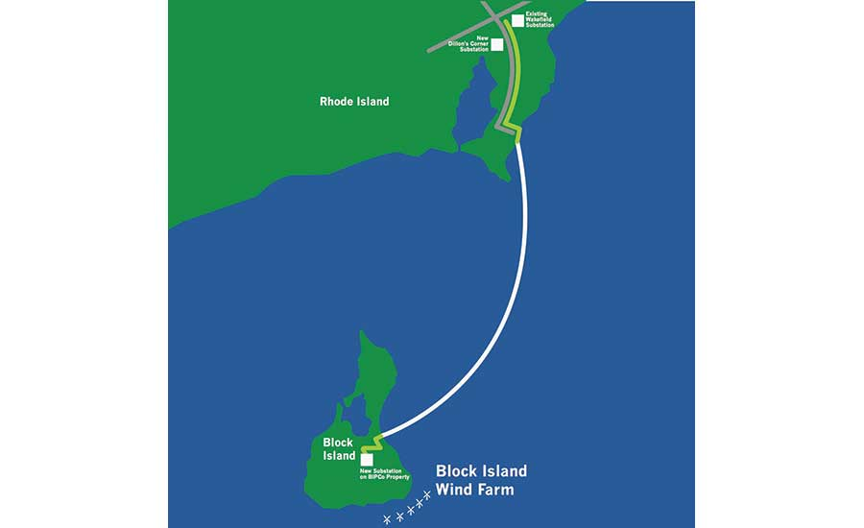
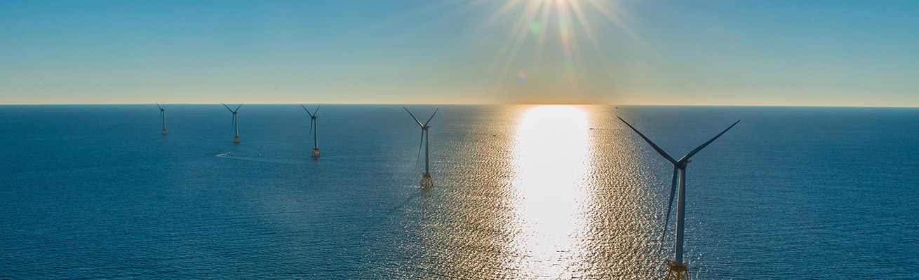

Slide 25
Rhode Island, continued
Reasons for success versus the Massachusetts project:
1: Unlike the Cape Cod Project, Block Island did not face local opposition.
2: The project was much smaller (5 turbines vs. 130)
3: Increased interest in wind power led to many parties interested in financing offshore wind projects
D. E. Shaw Group, a big investment firm based in Manhattan initially backed $300 million

Slide 26
Case Study 3: New York
2017: New York became the first state in the United States to publish a comprehensive Offshore Wind Master Plan. The plan set 2030 goal of 2,400 megawatts.
The plan created a roadmap for developers and for government
Identified and ‘greenlit’ offshore wind areas for development
Created bidding process for developers to encourage competition
Published an extensive list of environmental surveys for developers, cuts costs of developer needing to uncover ad hoc
Identified infrastructure requirements and cost reduction strategies

Slide 27
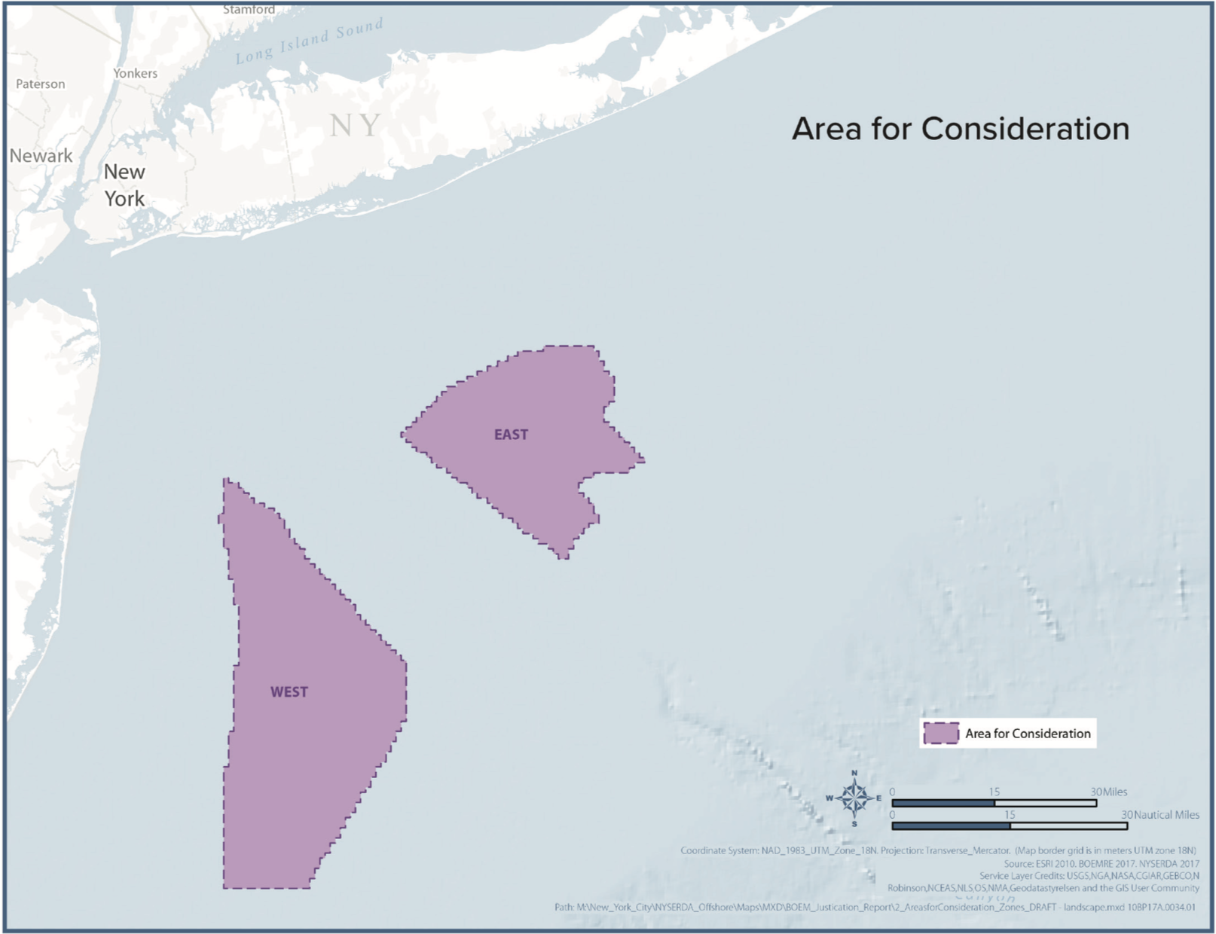

Slide 28
A closer look…
NY State surveys:
https://www.nyserda.ny.gov/About/Publications/Offshore-Wind-Plans-for-New-York-State
Note: While the Master Plan was published and now steers state policy (NY recently committed $5 million to offshore wind siting research), no concrete plans for an offshore wind farm have been announced.

Slide 29
Concluding Observations
Lessons learnt from American projects:
Careful consideration for political obstacles (e.g. wealthy landowners, special interest groups, etc.)
On that note: pre-screening mitigates potential conflict
Starting small to demonstrate viability (e.g. Block Island Project)
Offshore Wind Master Plans simplify process for developers
Existing, accessible studies reduce pending permit time, reduce costs for developers
Ease of accessing the information attracts developers, having a clear process removes uncertainty

Slide 30

And now “across the pond”

Slide 31
Part V: Comparison with the U.K.

Slide 32
Application Process
Create online account with MMO
Submit the required documents and pay associated fees
Agree to monitoring in order to begin construction
The application process w/in English and Welsh waters is clearer than the American cases. A developer must first:
The two items required to begin construction + the associated agencies that dispense them:
#1: FEPA License, issued by the Marine Management Org. (MMO)
#2: Decision of Consent, issued by the Dept. of Trade and Industry
The developer then works directly with the MMO for the project’s duration

Slide 33
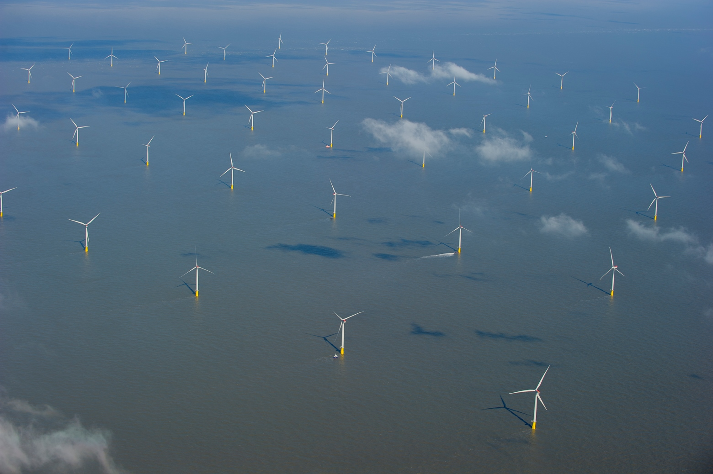
Case Study: London Array

Slide 34
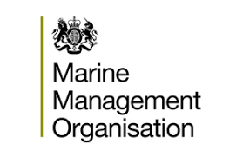

Process Part 1: Web Portal
Developer begins by creating profile on the MMO’s “Marine Case Management System” (link here).
Online portal (devs submit all required documents → receive FEPA license)
License allows commence construction and pay associated fees.
For wind projects, fees differ depending upon the size of the project.

Slide 35
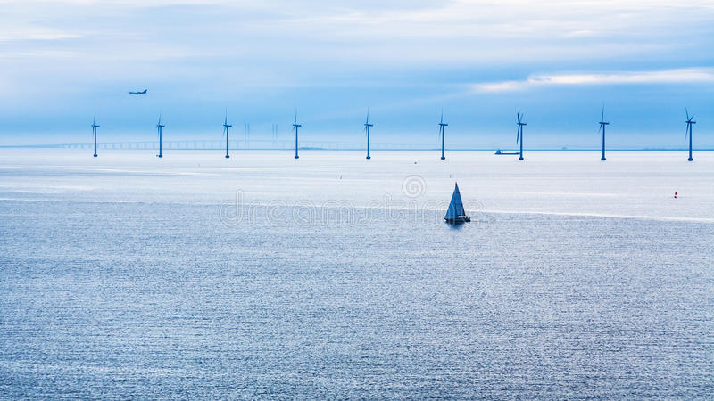
Process Part 1: Additional Note
One more permit that the developer must receive is a Decision of Consent from the Department of Trade and Industry’s Energy Resources and Development Unit, which under the Electricity Act of 1989’s Section 36, extinguishes the public right of navigation within the offshore wind farm’s vicinity. The document clearly defines the parameters and conditions through legal terms.

Slide 36
Process Part 2: Documentation
As part of this stage, the developer must submit an EIA and establish siting parameters. The developer must also agree to the responsibility of monitoring throughout the pre-construction, construction, and post-construction phases.
For wind farms, awarding a license requires compliance with certain stipulations: including
1) proof of conditions in place to prevent the damage or disturbance of sea beds;
2) conditions for the placement of sediment (beneficial use/recharge);
3) conditions for disposal site management (e.g. where construction equipment will be disposed);
4) conditions for chemical use, and;
5) and conditions for excavation or structural removal in case the need were to arise.
In addition to the disposal site conditions, the process also requires developers to provide evidence that they will have measures in place to prevent unlicensed waste at seas.

Slide 37
Process Part 3: Monitoring
Once permit is greenlit, the developer must provide the MMO with scheduling (3 parts: pre-construction, construction, post-construction).
Monitoring is a “living document” adjust for project duration.
The types of monitoring (pertinent to offshore): bathymetric surveys (side scan and multi-beam pertaining to the turbines), reef identification, grabs and trawls, otter and beam trawls, and electromagnetic fields desk review.

Slide 38
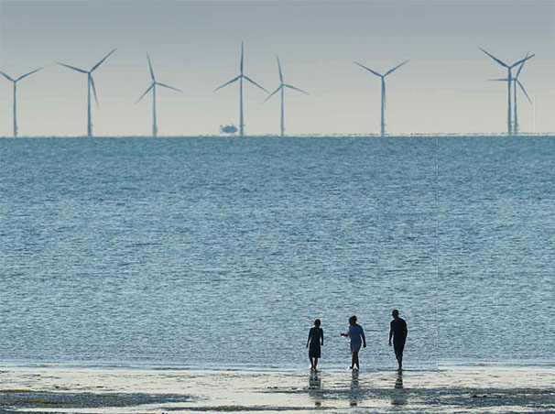
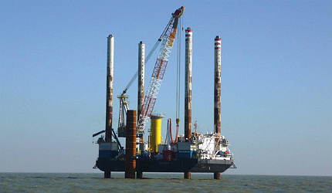
Process Part 3 Continued
All monitoring must report the following:
an executive summary of the results;
an assessment of the data quality;
detailed discussion of the results (including interpretation);
‘accuracy’ of results presented, and;
data examples.
Once construction is complete, the developer is required to continually submit post-construction reports to the government for two years to ensure continued compliance.

Slide 39


Critical Commentary
While clearer than the American model, the MMO’s portal apparently does not provide developers nor the public with estimated costs associated with monitoring
⬆ financial uncertainty, ⬇ incentive for investment

Slide 40
Recap (1)
Pre-construction permit required after EIAs, siting screenings, and monitoring agreements
Both countries require compliance with environmental acts
Types of licenses required:
marine building permit (siting, environmental compliance)
UK: revoking public navigation around the site
Which agencies are affiliated and distribute licenses?
USA, Federal: Department of Interior
USA, State: U.S. Marine Corp
UK: Marine Management Org., Dept. of Trade & Industry

Slide 41
Recap (2)
Administrative entities responsible for process: clear
USA: Process itself: vague, yet to be solidified
UK: process more established, would like to see more public information about costs

Slide 42
Sources:
Block Island Wind Farm. “About”. Deepwater Wind. http://dwwind.com/project/block-island-wind-farm/
Department of Trade and Industry. “London Array Letter of Consent Decision”. Government of the United Kingdom of Great Britain and Northern Ireland. Dated December 18, 2006. https://itportal.beis.gov.uk/EIP/pages/projects/LondonADecisionConsent.pdf
Gillis, Justin. “America’s First Offshore Wind Farm May Power Up a New Industry”. The New York Times, published August 22, 2016. https://www.nytimes.com/2016/08/23/science/americas-first-offshore-wind-farm-may-power-up-a-new-industry.html?action=click&module=RelatedCoverage&pgtype=Article&region=Footer
London Array. “Pre-Construction Marine Environment Monitoring Plan.” London Array Offshore Wind Farm. LAL Env Mon Plan (1): February, 2010, 1-26.
Marine Case Management System. “Apply for a Marine License”. Government of the United Kingdom of Great Britain and Northern Ireland. https://www.gov.uk/apply-marine-licence
New York State Energy Research and Development Authority. “New York State Offshore Wind Master Plan”. The State of New York. Albany, NY: 2018, 1-57.
Seelye, Katherine Q. “After 16 Years, Hopes for Cape Cod Wind Farm Float Away”. The New York Times, published December 19, 2017. https://www.nytimes.com/2017/12/19/us/offshore-cape-wind-farm.html
Shumkov, Ivan. “New York allocates USD 5m for offshore wind data collection”. Renewables Now, published May 2, 2018. https://renewablesnow.com/news/new-york-allocates-usd-5m-for-offshore-wind-data-collection-611012/
4COffshore. “Block Island Wind Farm Offshore Wind Farm”. Last updated December 5, 2017. https://www.4coffshore.com/windfarms/block-island-wind-farm-united-states-us12.html

